Slide 1
BRITISH AIRWAYS
Web scraping to gain company insights
2/05/2024

Slide 2
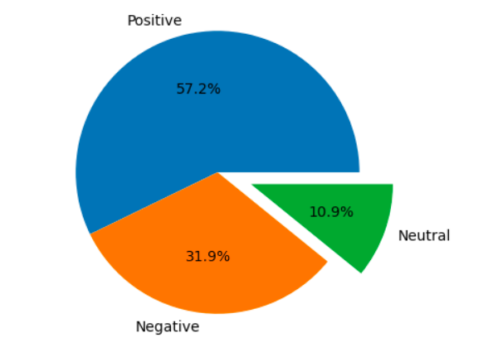
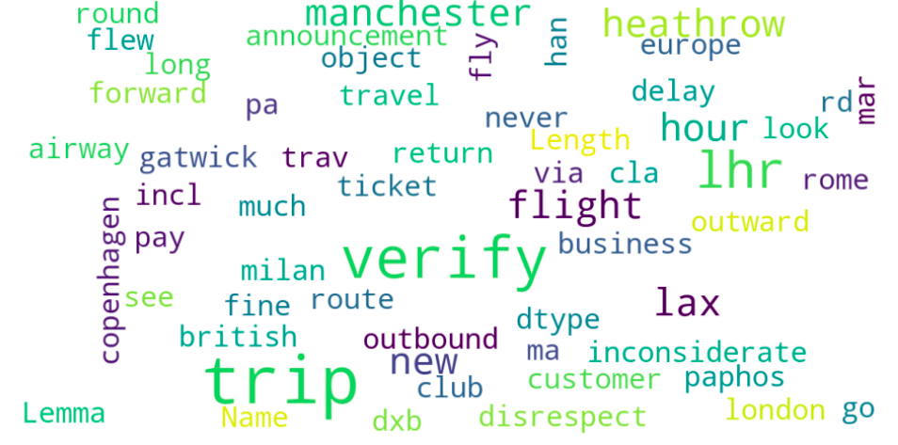
INSIGHTS FROM CUSTOMER REVIEWS
We obtained:
Positive Reviews - 2117
Negative Reviews - 1181
Neutral Reviews – 402
Word cloud of keywords used in reviews

